Slide 1
Examining
Numerical Data

Slide 2

Mean
The sample mean, denoted as x̄, can be calculated as
where x₁, x₂, ..., x_{n} represent the n observed values.
The population mean is also computed the same way but is denoted as µ. It is often not possible to calculate µ since population data are rarely available.
The sample mean is a sample statistic, and serves as a point estimate of the population mean. This estimate may not be perfect, but if the sample is good (representative of the population), it is usually a pretty good estimate.

Slide 3
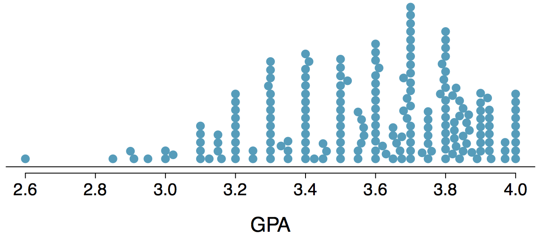
Dot Plot
Higher bars represent areas where there are more observations, makes it a little easier to judge the center and the shape of the distribution.

Slide 4
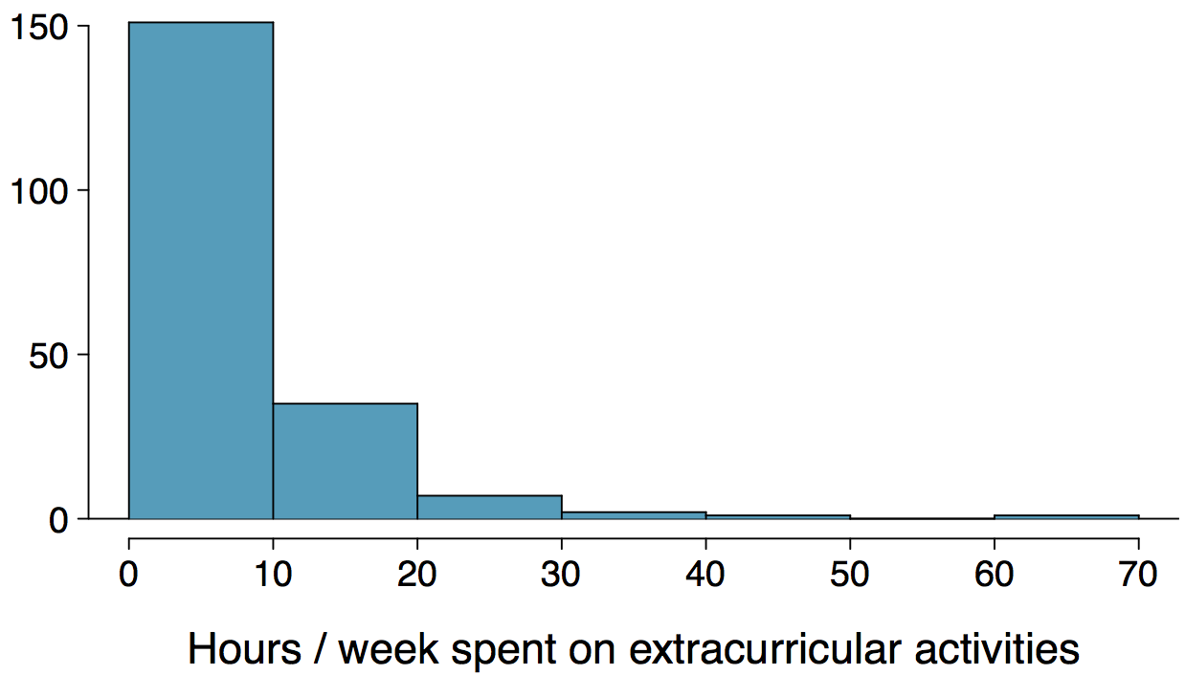
Histograms - Extracurricular Hours
Histograms provide a view of the data density. Higher bars represent where the data are relatively more common.
Histograms are especially convenient for describing the shape of the data distribution.
The chosen bin width can alter the story the histogram is telling.

Slide 5
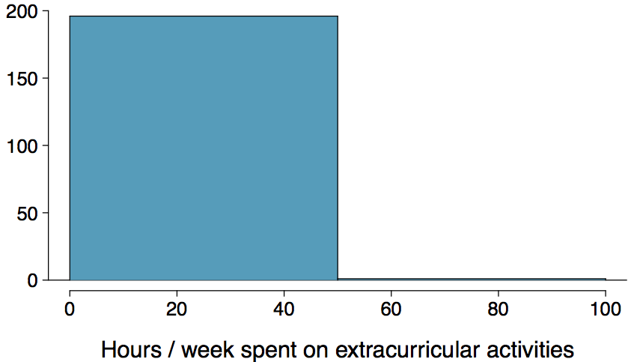
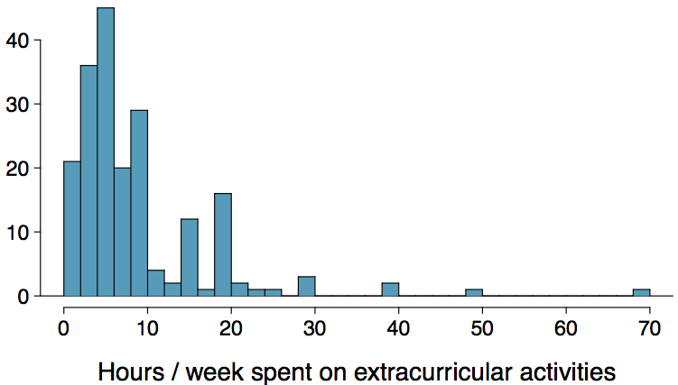
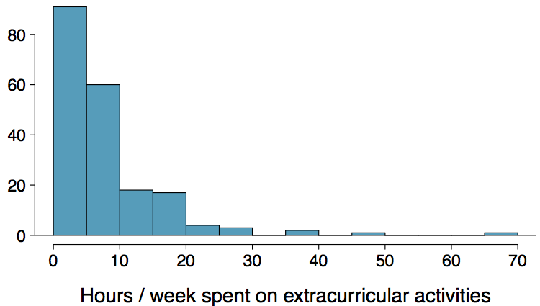
Bin Width
Which one(s) of these histograms are useful? Which reveal too much about the data? Which hide too much?

Slide 6
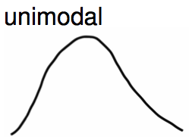
Commonly observed shapes of distributions
Modality

Slide 7
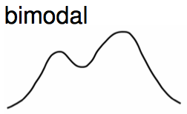
Commonly observed shapes of distributions
Modality

Slide 8
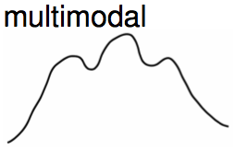
Commonly observed shapes of distributions
Modality

Slide 9
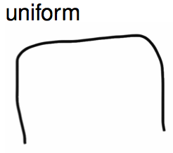
Commonly observed shapes of distributions
Modality

Slide 10
Commonly observed shapes of distributions
Modality
Skewness

Slide 11
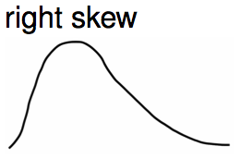
Commonly observed shapes of distributions
Modality
Skewness

Slide 12
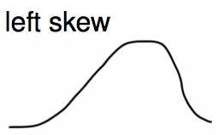
Commonly observed shapes of distributions
Modality
Skewness

Slide 13
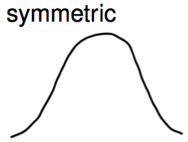
Commonly observed shapes of distributions
Modality
Skewness

Slide 14
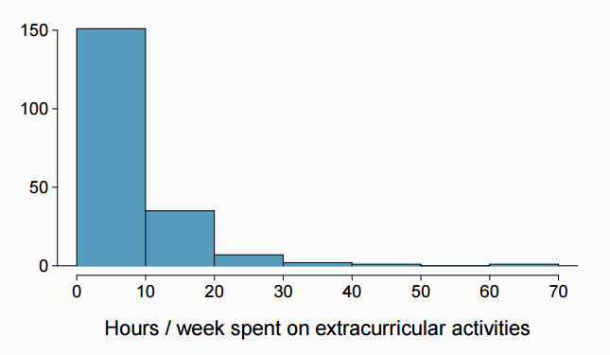
Extracurricular activities
How would you describe the shape of the distribution of hours per week students spend on extracurricular activities?

Slide 15
Extracurricular activities
How would you describe the shape of the distribution of hours per week students spend on extracurricular activities?
Unimodal and right skewed.

Slide 16
Practice
Which of these variables do you expect to be uniformly distributed?
(a) weights of adult females
(b) salaries of a random sample of people from North Carolina
(c) house prices
(d) birthdays of classmates (day of the month)

Slide 17
Practice
Which of these variables do you expect to be uniformly distributed?
(a) weights of adult females
(b) salaries of a random sample of people from North Carolina
(c) house prices
(d) birthdays of classmates (day of the month)

Slide 18

Are you typical?
http://www.youtube.com/watch?v=4B2xOvKFFz4

Slide 19
Are you typical?
http://www.youtube.com/watch?v=4B2xOvKFFz4
How useful are centers alone for conveying the true characteristics of a distribution?

Slide 20

Variance
Variance is roughly the average squared deviation from the mean.

Slide 21

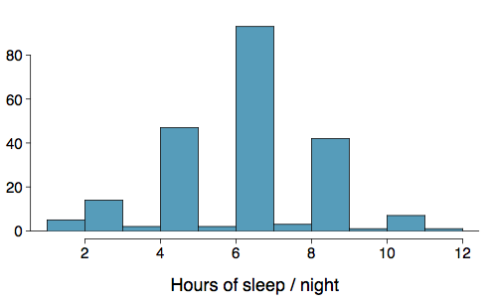
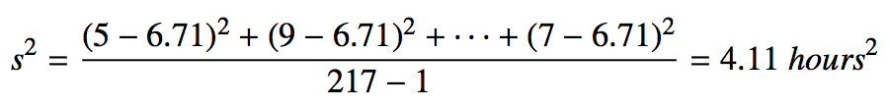
Variance
Variance is roughly the average squared deviation from the mean.
The sample mean is and the sample size is n = 217.
The variance of amount of sleep students get per night can be calculated as:

Slide 22
Variance (cont.)
Why do we use the squared deviation in the calculation of variance?
To get rid of negatives so that observations equally distant from the mean are weighed equally.
To weigh larger deviations more heavily.

Slide 23

Standard Deviation
The standard deviation is the square root of the variance, and has the same units as the data.

Slide 24
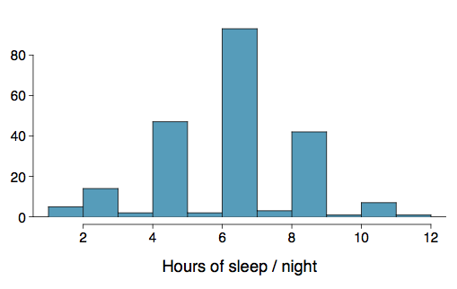

Standard Deviation
The standard deviation is the square root of the variance, and has the same units as the data.
The standard deviation of amount of sleep students get per night can be calculated as:
We can see that all of the data are within 3 standard deviations of the mean.

Slide 25

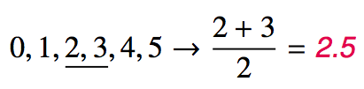
Median
The median is the value that splits the data in half when ordered in ascending order.
If there are an even number of observations, then the median is the average of the two values in the middle.
Since the median is the midpoint of the data, 50% of the values are below it. Hence, it is also the 50th percentile.

Slide 26
Q1, Q3, and IQR
The 25th percentile is also called the first quartile, Q1.
The 50th percentile is also called the median.
The 75th percentile is also called the third quartile, Q3.
Between Q1 and Q3 is the middle 50% of the data. The range these data span is called the interquartile range, or the IQR.
IQR = Q3 - Q1

Slide 27
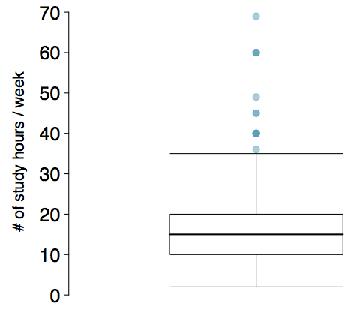
Box Plot
The box in a box plot represents the middle 50% of the data, and the thick line in the box is the median.

Slide 28
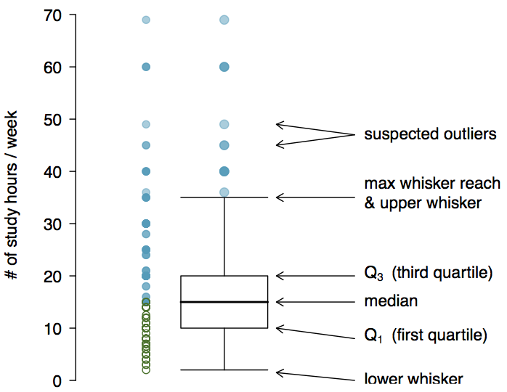
Anatomy of a Box Plot

Slide 29
Whiskers and Outliers
Whiskers of a box plot can extend up to 1.5 x IQR away from the quartiles.
max upper whisker reach = Q3 + 1.5 x IQR
max lower whisker reach = Q1 - 1.5 x IQR

Slide 30
Whiskers and Outliers
Whiskers of a box plot can extend up to 1.5 x IQR away from the quartiles.
max upper whisker reach = Q3 + 1.5 x IQR
max lower whisker reach = Q1 - 1.5 x IQR
A potential outlier is defined as an observation beyond the maximum reach of the whiskers. It is an observation that appears extreme relative to the rest of the data.

Slide 31
Outliers (cont.)
Why is it important to look for outliers?

Slide 32
Outliers (cont.)
Why is it important to look for outliers?
Identify extreme skew in the distribution.
Identify data collection and entry errors.
Provide insight into interesting features of the data.

Slide 33
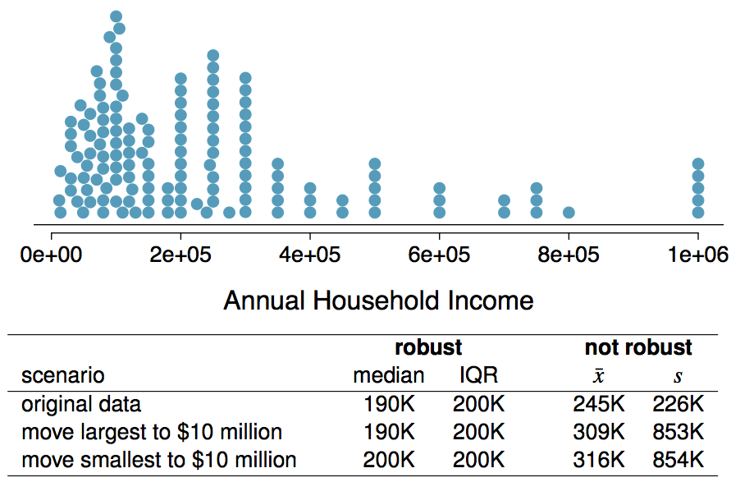
Robust Statistics

Slide 34
Robust Statistics
Median and IQR are more robust to skewness and outliers than mean and SD. Therefore,
for skewed distributions it is often more helpful to use median and IQR to describe the center and spread
for symmetric distributions it is often more helpful to use the mean and SD to describe the center and spread

Slide 35
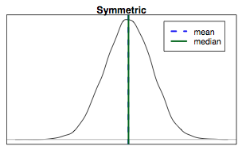
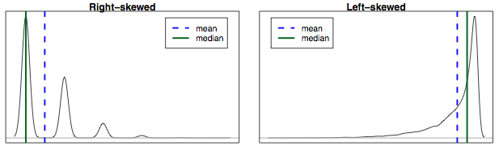
Mean vs. Median
If the distribution is symmetric, center is often defined as the mean: mean ~ median
If the distribution is skewed or has extreme outliers, center is often defined as the median
Right-skewed: mean > median
Left-skewed: mean < median

Slide 36
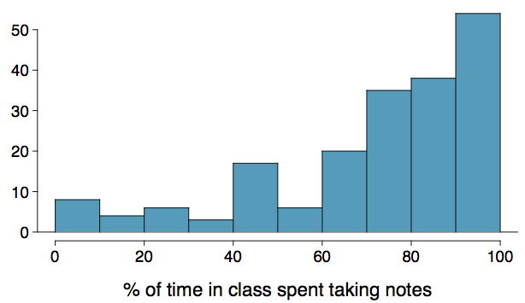
Practice
Which is most likely true for the distribution of percentage of time actually spent taking notes in class versus on Facebook, Twitter, etc.?
(a) mean > median (b) mean ~ median
(c) mean < median (d) impossible to tell

Slide 37
Practice
Which is most likely true for the distribution of percentage of time actually spent taking notes in class versus on Facebook, Twitter, etc.?
median: 80%
mean: 76%
(a) mean > median (b) mean ~ median
(c) mean < median (d) impossible to tell

